Slide 1




Perfect Eats: India

Slide 2
Introduction
The capital of India, New Delhi has a population of 257,803, but the much larger metro area has a population of more than 26 million.
The city if very diverse and has cultural taste from ranging from Chinese , Italian , French and more.

Slide 3
Objectives
Where is best Chinese Cuisine in New Delhi City?
Where is the highest concentrations of Chinese Restaurant Market?
What areas have the least number of restaurants?
Where is the best place to stay if you want Chinese Cuisine ?
What areas have the highest rated restaurants in New Delhi?

Slide 4
Data
New Delhi Restaurants data
List Locality
Restaurant Name
Rating
Latitude and longitude

Slide 5
Data
Data source : Zomato Kaggel Dataset
Description : This data set contains the required information. And we will use this data set to explore various locality of new Delhi city.
Nearby places in each locality of new Delhi City.
Data source : Foursquare API
Description : Using this API we will get all the venues in each neighborhood.

Slide 6
Approach
Collect Delhi City data from Zomato Kaggel dataset
Use Foursquare API to find all venues for each neighborhood.
Filter all venues that are nearby by locality.
Use aggregative rating for each restaurant to find the best places.
Visualize the ranking of neighborhoods using folium library (Python)

Slide 7
Results

Slide 8
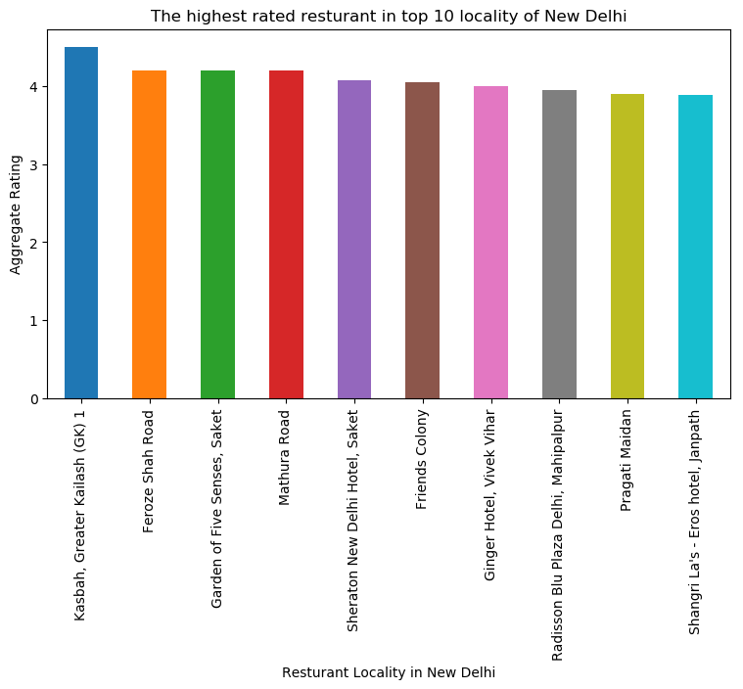

Slide 9
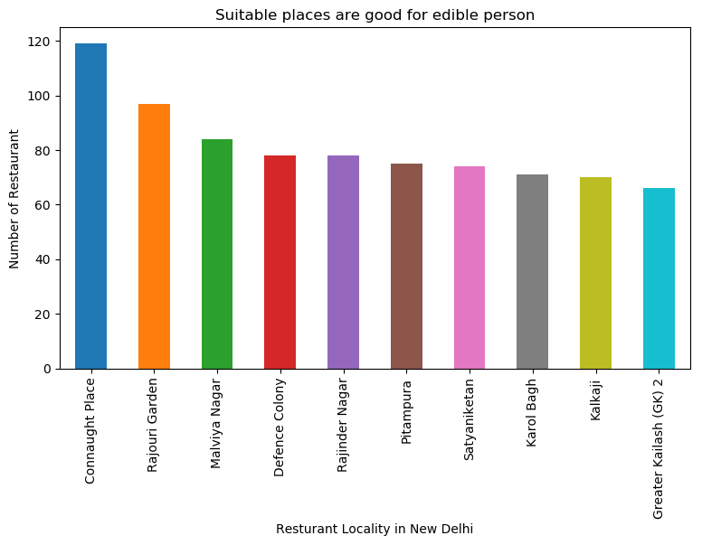

Slide 10
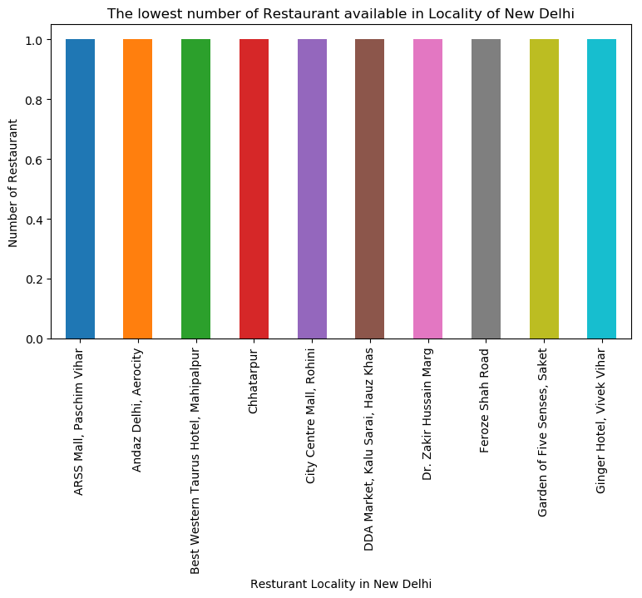

Slide 11
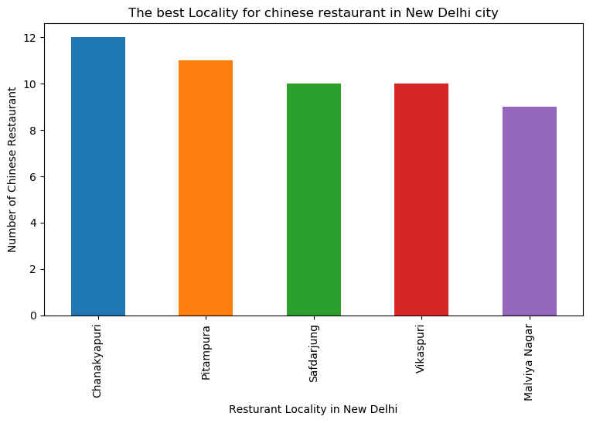

Slide 12
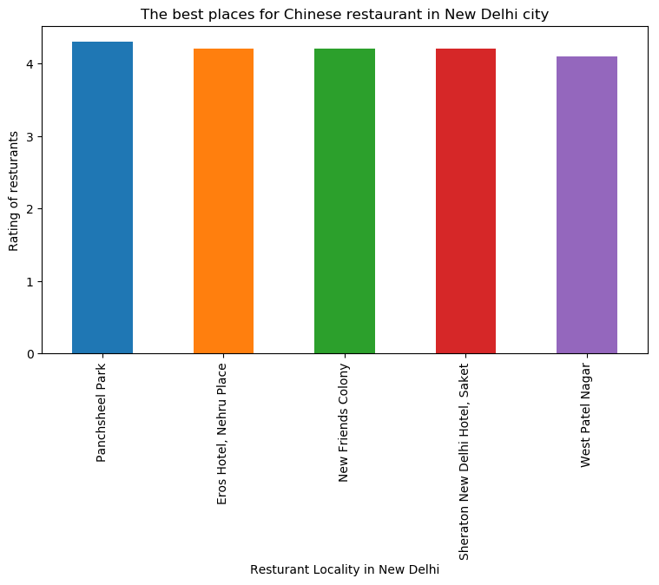

Slide 13


Slide 14
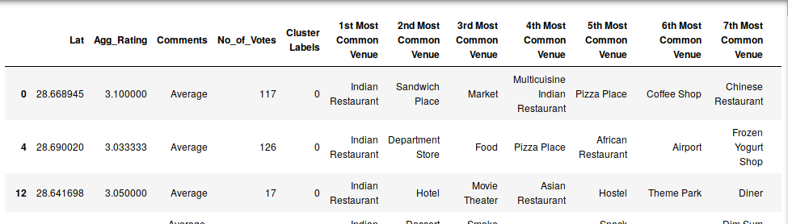
Cluster 1:
Indian Cuisine:

Slide 15
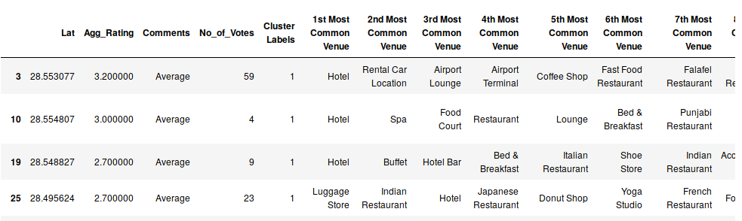
Cluster 2:
Hotel and Nightclubs:

Slide 16
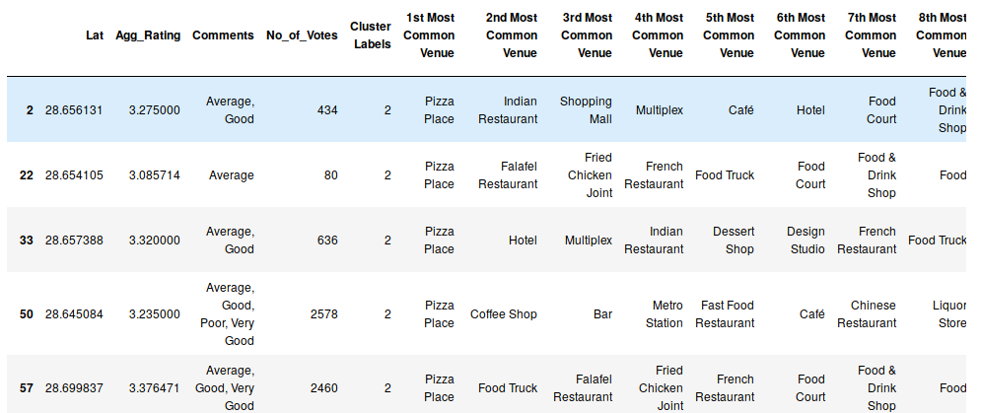
Cluster 3:
Pizza:

Slide 17
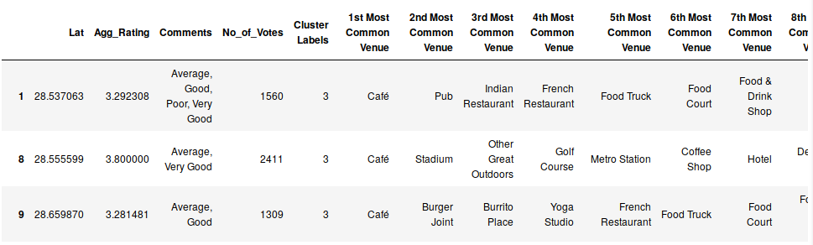
Cluster 4:
Cafes:

Slide 18
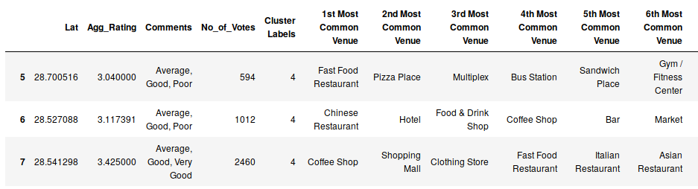
Cluster 5:
Fast-food and Cafes

Slide 19
Conclusion
Chanakyapuri, Pitampura, Safdarjung best neighborhoods for Chinese cuisine.
Panchsheel park and Nehru place have the best Chinese Restaurant.
Connaught place, Rajouri garden and Malviya nagar are the best places to eat.
Greater kailash, Feroze shah road, Saket have best rated restaurants in New Delhi.

